Slide 1
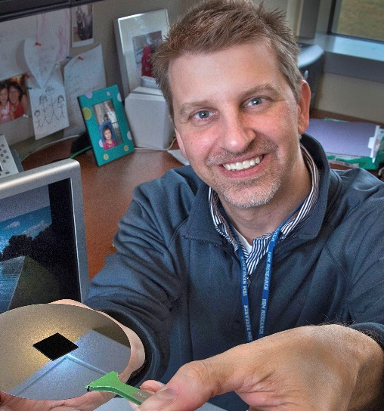
Dr. Charles T. Black
“Engineering Material Properties Using Block Copolymer Self Assembly”
Abstract:
Block copolymer thin films provide a robust method for generating regular, uniform patterns at length scales in the range of ten nanometers, over arbitrarily large areas. A significant advantage of such block copolymer-based patterning is its ease of integration with all other aspects of traditional thin-film processing, including plasma-based etching and metallization. Because of the dearth of other high resolution, high-throughput patterning options, block copolymers are under intense scrutiny by the information technology industry for lithography enhancement – an application with extreme demands on pattern uniformity.
However, such process compatibility ensures a host of other application opportunities in designing material properties through control of the internal nanostructure. For example, I will describe our recent use of block copolymer self assembly in engineering broadband omnidirectional anti-reflecting surfaces for solar devices. Precisely controlling surface texture through block copolymer-based patterning can also render a material superhydrophobic, and able to remain water-repellent during droplet impacts at speeds in excess of 10 meters per second.
The Center for Functional Nanomaterials (CFN) at Brookhaven National Laboratory is a science-based user facility funded by the U.S. Department of Energy, devoted to nanotechnology research addressing challenges in energy security. The goal for the CFN is to be an enabling resource for advanced materials research within the United States by offering a broad portfolio of scientific capabilities accessible to external researchers at no cost via a peer-reviewed proposal process.
Dr. Charles T. Black
Center for Functional Nanomaterials
Brookhaven National Laboratory
735 Brookhaven Avenue
Upton, NY 11973
Phone: (631) 344-4397; Email: ctblack.bnl@gmail.com
Bio:
Dr. Charles Black is a Scientist and the Group Leader for Electronic Nanomaterials in the Center for Functional Nanomaterials, a US Department of Energy User Facility at Brookhaven National Laboratory. Dr. Black manages a group of 10 scientists exploring the use of nanostructures for solar energy conversion. Currently, Dr. Black’s research interests include using nanostructured materials and self-assembly approaches in solar devices.
From 1996 to 2006 Dr. Black was a Research Staff Member at the IBM Thomas J. Watson Research Center in Yorktown Heights, New York. His research at IBM investigated using polymer self assembly for fabrication of high-performance semiconductor electronics. During his career Dr. Black has also performed experimental research in low-temperature scanning tunneling microscopy, single-electron tunneling devices, superconductivity in metal nanoparticles, nanocrystal-based electronic devices, and ferroelectric non-volatile memories.
Dr. Black earned the Ph.D. degree in Physics from Harvard University in 1996, and B.S. degrees in Physics and Mathematics from Vanderbilt University in 1991. He has authored more than 80 scientific
publications and conference proceedings, and four chapters of
books. He currently holds 44 US Patents. Dr. Black is a Fellow of
the American Physical Society and Senior Member of the IEEE.
DATE: May 13, 2015
time: 11:15am-12:15pm
Location: 310 Kelly Hall/ICTAS I

